Slide 1

Case planning and Statement of Work (SOW)
<number> | 2010

Slide 2
Congratulations.
You have won the contract!
The customer need his product a.s.a.p.
So, get started now!

Slide 3
Case work flow
Terma case
Systematic case
Terma case
Systematic case
SoW
U.C. Req.
SoW
U.C. Req.
SoW
U.C. Req.
SoW
U.C. Req.
Contract to
prime
MRS
Del. Doc.
Contract to
prime
MRS
Del. Doc.
Contract to
prime
MRS
Del. Doc.
Contract to
prime
MRS
Del. Doc.
Company
A
Contract to
subcontractor
Company
B
Contract to
subcontractor
Company
C
Contract to
subcontractor
Company
D
MRS
Del. Doc.
MRS
Del. Doc.
MRS
Del. Doc.
Contract to
subcontractor
MRS
Del. Doc.
Contract to
subcontractor
MRS
Del. Doc.
Company
E
Contract to
subcontractor
Company
F
Contract to
subcontractor
Company
G
Contract to
subcontractor
Company
H
MRS
Del. Doc.
MRS
Del. Doc.
MRS
Del. Doc.
Contract to
prime
MRS
Del. Doc.
Contract to
prime
MRS
Del. Doc.
Contract to
prime
MRS
Del. Doc.
Contract to
prime
MRS
Del. Doc.
Terma case
Systematic case
Terma case
Systematic case
SoW
U.C. Req.
SoW
U.C. Req.
SoW
U.C. Req.
SoW
U.C. Req.
MRS – Milestone review
Del. Doc = deliverable documentations
U.C. Req. = Use Case Requirements
<number> | 2010

Slide 4
Contractors and sub-contractors
Company A
  Prime contractor to Terma case
  Subcontractor to Company B
Company B
  Prime contractor to Systematic case
  Subcontractor to Company C
Company C
  Prime contractor to Terma case
  Subcontractor to Company D
Company D
  Prime contractor to Systematic case
  Subcontractor to Company H
Company E
  Prime contractor to Terma case
  Subcontractor to Company A
Company F
  Prime contractor to Systematic case
  Subcontractor to Company E
Company G
  Prime contractor to Terma case
  Subcontractor to Company F
Company H
  Prime contractor to Systematic case
  Subcontractor to Company G
<number> | 2010

Slide 5
Case input: Customer requirements
Terma
Statement of Work
Use Case Requirements (U.C. Req.)
Systematic
Statement of Work
Use Case Requirements (U.C. Req.)
<number> | 2010

Slide 6
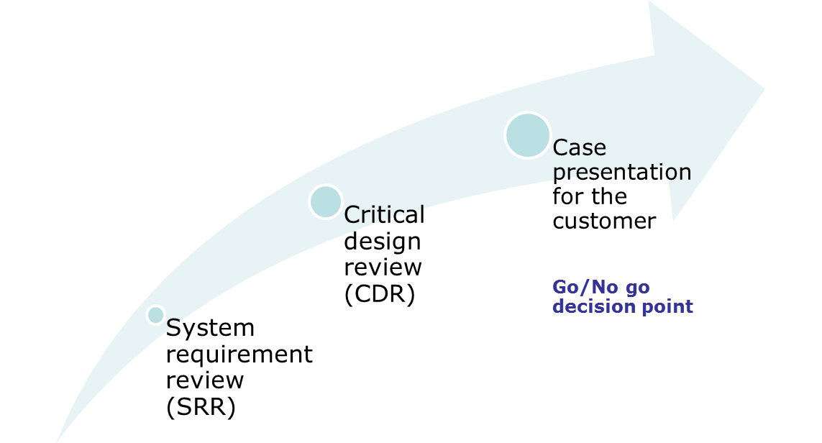

Timeline for case work
15/10-2010
11/10-2010
28/9-2010
3/9-2010
Contract win
<number> | 2010

Slide 7
Responsibilities (1 of 2)
Prime-contractor’s MSR with the end-customer and the QA consultant:
  All documents for the MSR shall be delivered to the customer no less that 72 hours in advance
  Delivery information:
  Terma: mhn@terma.com; mih@terma.com; tov@terma.com
  Systematic: Anders.Jacob.Truelsen@Systematic.com
  QA consultant: rhj@iha.dk
  All documents shall be in PDF format
  All documents shall be revision controlled
  The MSR shall be conducted at an agreed time on the dates specified by the end-customer
  It is the prime-contractor’s responsibility that the MSR time is not conflicting with other MSR’s
<number> | 2010

Slide 8
Responsibilities (2 of 2)
Subcontractor’s MSR with the prime-contractor:
  The MSR shall be conducted outside class lectures
  The requirements for the documentation is the same as for the prime-contractor’s MSR with the end-customer.
  Minutes of Meeting (MoM) from the MSR shall be sent to the end-customer and the QA consultant by the prime contractor no less that 48 hours after the MSR meeting
  MoM shall be in PDF format containing a max. of 1000 words.
<number> | 2010

Slide 9
Systems Engineering teams in companies A-H
Company A Nikki Amos Jeremi Søren A.M. Lasse H.R. Nikolaj T. Anders P. | Company B Rony Jesper J. Zoi Allan K.N. Teddy Søren D. Ba Thy Thu | Company C Brian V.D. Kristoffer Frederik Ø.L. Anders B.N. Maria S.C. Lasse V.H. | Company D José Antonio Adam Martin S.M. Martin G.O. Rene Lars W.J.
Company E Kenneth Christian J. David Michael N.P. Anders T. Peter H.M. | Company F Lars M. Hardy Saiid Lise Anders H.P. | Company G Frank A. Bodil Torben T.D. Morten O.J. Klaus K. Kaj | Company H Anders B. Jesper B. Jørgen V.H. Jens K. Ole L.
Think of appointing a prime contact/spokes person for the team today
and share contact information.
<number> | 2010

Slide 10
Questions and support issues
Planned consultation (17/9 at 10-12)
An optional consultation is planned at IHA. Location to be announced on CampusNet. Companies shall send only one representative.
Questions sent no later that 48 hours before the consultation will be given highest priority. Questions must be prioritized due to time constraints.
Contact information for QA consultant
  Rune Jacobsen (rhj@iha.dk)
  IHA, Office 407b
  Phone: +45 8730 2526
<number> | 2010

